Slide 1


DEPARTMENT OF COMPUTER SCIENCE ENGINEERING
TECHNICAL SEMINAR ON
A LASER COMMUNICATION SYSTEM
Under the Guidance of :
Mrs. Pushpalata Dubey
Asst. Professor
Presented by :
Ashrafulla khan(1RG16CS018)

Slide 2
Contents
ABSTRACT
INTRODUCTION TO LASER
FEATURES OF LASER COMMUNICATION SYSTEM
COMPARISION
DESIGN
OPERATION
MODULATING AND GAIN SYSTEM
ADVANTAGES AND LIMITATIONS
APPLICATION
OUTLOOK
CONCLUSION
REFERENCE

Slide 3
Abstract
Laser communications offer a viable alternative to RF communications for inter satellite links and other applications. High data rate, small antenna size, narrow beam divergence, and a narrow field of view are characteristics of laser communications that offer a number of potential advantages for system design.
Lasers have been considered for space communications. Advances in system architecture, data formatting and component technology over the past three decades have made laser communications in space not only viable but also an attractive approach into inter satellite link applications.
Information transfer is driving the requirements to higher data rates, laser cross -link
technology explosions, global development activity, increased hardware, and design
maturity. Most important in space laser communications has been the development of
a reliable, high power, single mode laser diode as a directly moldable laser source.
Laser communication systems offer many advantages over radio frequency (RF) systems. Some advantages of laser communications over RF are smaller antenna size, lower weight, lower power and minimal integration impact on the satellite. Laser communication is capable of much higher data rates than RF.

Slide 4
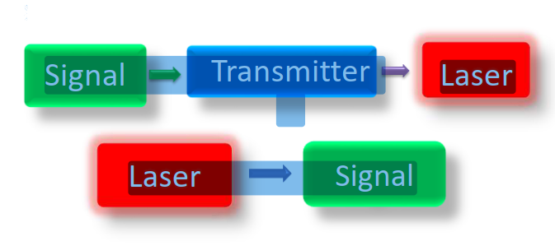
Introduction to Laser
LASER: laser is a device that emits light through a process of optical amplification based on the simulated emission of electromagnetic radiation.
communication: exchange the information from one place to another place.
Laser communication: it’s a system used as a wireless connection whose exchange
information through laser beam which is transmitted through free space.
Fig : Block diagram of laser communication

Slide 5
Features
Information is, typically in the form of digital data, is input to data electronics that modulates the transmitting laser source.
Direct or indirect modulation techniques may be employed depending on the type of laser employed.
The source output passes through an optical system into the channel. The optical system typically includes transfer, beam shaping, and telescope optics.
The receiver beam comes in through the optical system and is passed along to detectors and signal processing electronics.

Slide 6
Comparison
LASER COMMUNICATION SYSTEM
RADIO FREQUENCY SYSTEM
Laser light travels in a much higher frequency than radio waves.
Laser communication encodes more data.
The laser communication system is considered to operate in the near infrared from 0.8 to 1.1 micrometres
The main advantage of using laser communication over radio waves is increased bandwidth, enabling the transfer of more data in less time.
Radio frequency has longer wavelengths compared to optical frequencies.
Radio frequencies encodes data in a limit.
The R.F system is a millimetre wave system operating in the 60GHz,region of electromagnetic spectrum.

Slide 7
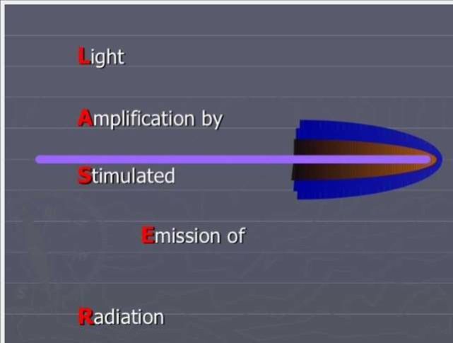
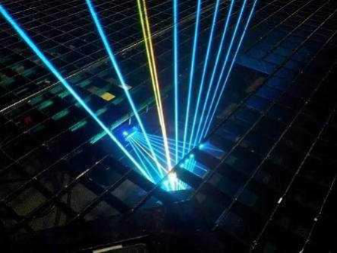
LASER COMMUNICATION DESIGN
laser design
laser beam

Slide 8
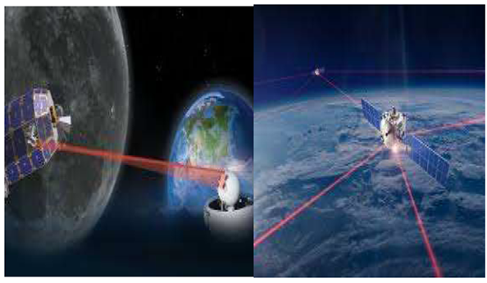
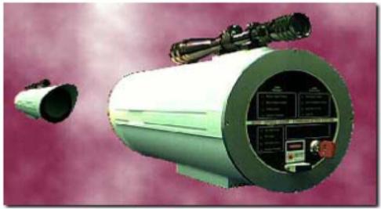
OPERATION
Free space laser communications systems are wireless connections through the atmosphere. They work similar to fibre optic cable systems except the beam is transmitted through open space.
The carrier used for the transmission of this signal is generated by either a high power LED or a laser diode. The laser systems operate in the near infrared region of the spectrum. The laser light across the link is at a wavelength of between 780 – 920 nm. Two parallel beams
are used, one for transmission and one for reception.
Space laser communication
high-speed laser communication system

Slide 9
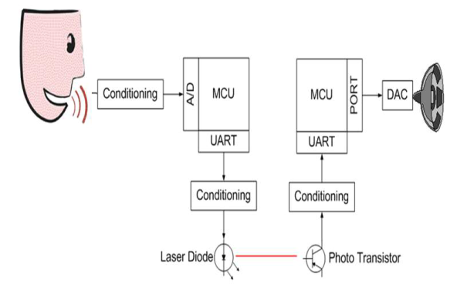
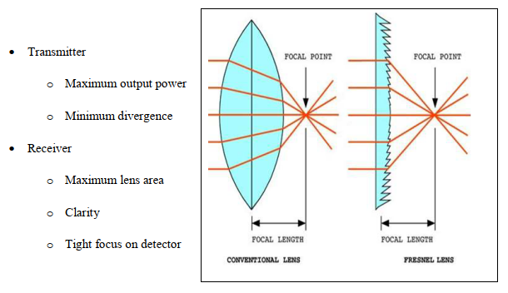
MODULATING AND GAIN SYSTEM
MODULATING SYSTEM
GAIN SYSTEM

Slide 10
ADVANTAGES
LIMITATIONS
High speed carrier.
High bandwidth(wavelength seperation of 1 nm,can give bandwidths of hundreds of Gigaherz).
Generation of narrow pulses for high bit-rate .
Small transmission loss,long transmission distance.
High communication quality,large communication capacity.
The essential drawback of free space laser communications systems is that they require direct line-of-sight.
Operational distance is also a variable if there are Intervening materials such as rain, smoke, fog, glass etc. which reduce the light intensity by a combination of absorption and refraction.
Pointing stability in wind distracts the communication.
Shadowing
Interference from background light sources(including the sun).

Slide 11
APPLICATIONS
Suitable for temporary connectivity needs such as at conventions, sporting events, corporate and university campuses, disaster scenes or military operations.
With the rapid development of terrestrial fibre communications, a wide array of components are available for potential application in space. These include detectors, lasers, multiplexers, amplifiers, drive electronics, optical preamplifiers, and others.
Defense and sensitive areas at airports for communication across runways, mass communication ,NASA satellite – satellite communication.
Ease of deployment
Can be used to power devices
High bit rates
Low bit error rates
Immunity to electromagnetic interference
Protocol transparency
Increased security when working with narrow beam.

Slide 12
OUTLOOK
Lasers may also be a key player in future energy plans. For example, they could detect changes in the wind to ensure wind turbines are positioned to capture as much power as possible, or perhaps be part of laser-activated fusion that could become an energy source.
Intel believes that in the future, lasers could be used to develop extremely fast communications systems when integrated with silicon photonics.
In April 2021 NASA's Laser Communications Relay Demonstration should launch as part of USAF STP-3, to communications between GEO and the Earth's surface. Laser communications in deep space will be tested on the Psyche mission to the main-belt asteroid 16 Psyche, planned to launch in 2022.
It is more secure and provides high bandwidth requirements.The low power consumption is also a great advantage.It can be mostly used technique worldwide in near future.

Slide 13
CONCLUSION
The system and component technology necessary for successful intersatellite laser
communication link exist today. The growing requirements for efficient and secure
communications has led to increased interest in the operational deployment of laser crosslinks for commercial and military satellite systems in both low earth and geosynchronous orbits. With the dramatic increase in the data handling requirement for satellite communication services, laser intersatellite links offer an attractive alternative to RF with virtually unlimited growth potential and an unregulated spectrum. The demonstration programs underway in the United States, Europe, and Japan will show the way for future large-scale applications of laser communications to satellite cross-links.

Slide 14
REFERENCE
IEEE communications Magazine. August 2000, free space laser communications: Laser cross-link systems and technology by: David L. Begley, Ball Aerospace & technologies corporation .
Free Space Optics or Laser Communication through the Air BY: Dennis Kiplinger Optics & Photonics News.
www.mindstein.net Laser communication.pdf
www.bestneo.com Lasercommunicationsystem.pdf
server4.oersted.dtu.dk/courses/31825/Project11.pdf

Slide 15
Thanks!

